Slide 1
PHD Progression 3
Explainable AI with Visual analytics

Slide 2
Explainable AI Recipes: Implement solutions to model
How SHAP works
SHAP requires model retraining on all feature subsets; hence, usually it takes time if the explanation has to be generated for larger datasets.
Identify a feature set from a list of features (selecting a subset of features out of all the features available, for instance 5 out of 15)
For any of the selected subset of features, two models will be created, one with the feature and another without the feature.

Slide 3
Explainable AI Recipes: Implement solutions to model
Then the prediction differences will be computed
The differences in the prediction are computed for all possible subsets of features.
The weighted average value of all possible differences is used to populate the feature of importance.
If the weighted average value is 0.000, then we can conclude that the feature is not important and has not joined the model. If the weighted average is greater than 0.000, then we can say it has a role to play in the model's prediction.

Slide 4
Applying SHAP to a Linear Regression model
Using the energydata_complete.csv data that is openly available online
SHAP value for each feature
The base value
The original training data

Slide 5
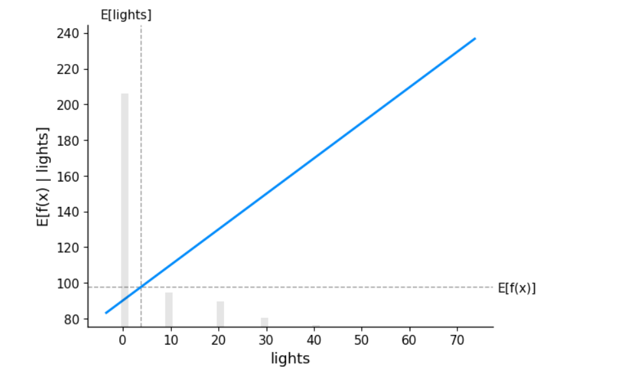
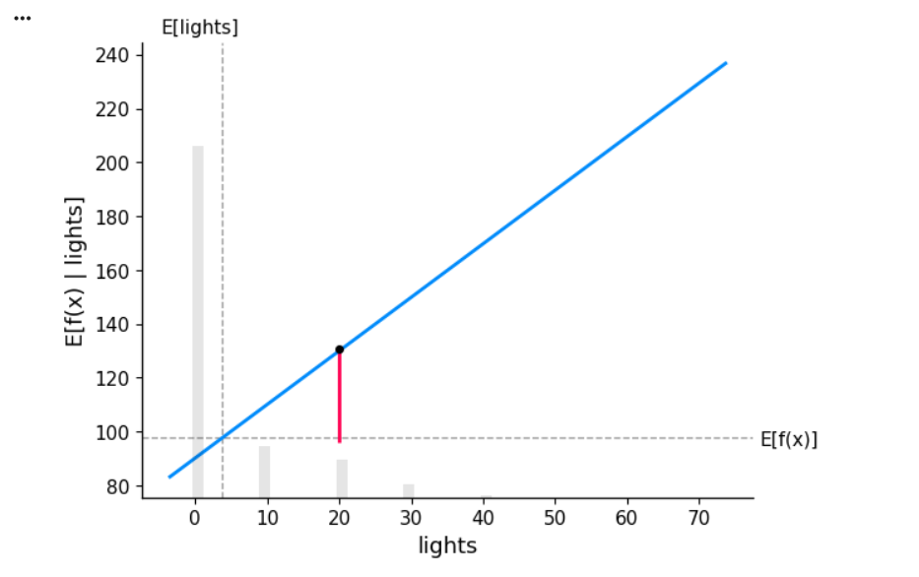
getting the partial dependency plot for SHAP
-Standard partial dependence plot for lights on predicted output for row number 20 from the training dataset
-Standard partial dependence plot for lights on predicted output

Slide 6
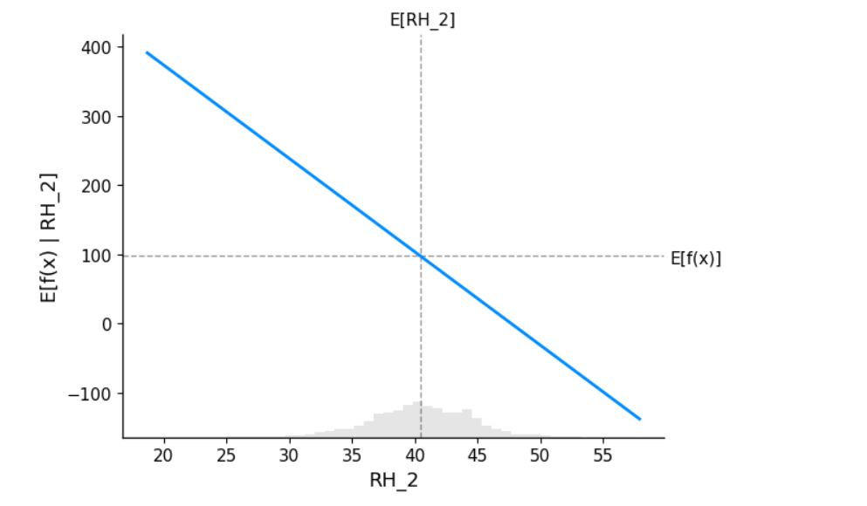
getting the partial dependency plot for SHAP
-Standard partial dependence plot for RH_2 on predicted output

Slide 7
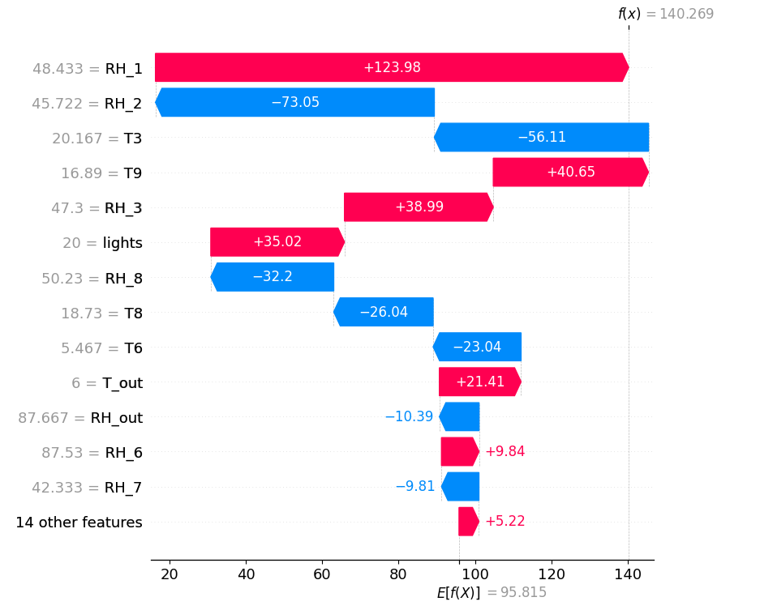
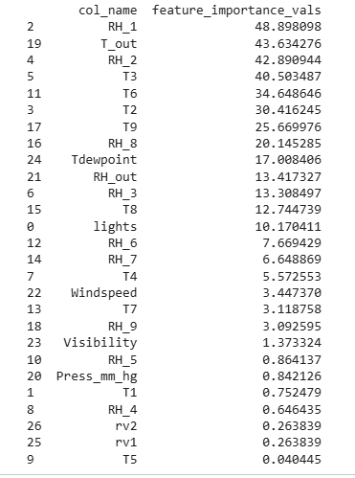
getting the waterfall plot and feature importance
-Getting the waterfall plot shows how we get from the SHAP values to the model's prediction at a particular instance of the sample, in this case 20(local explainbility)
- Getting the feature importance helps to understand the global effect of each feature

Slide 8
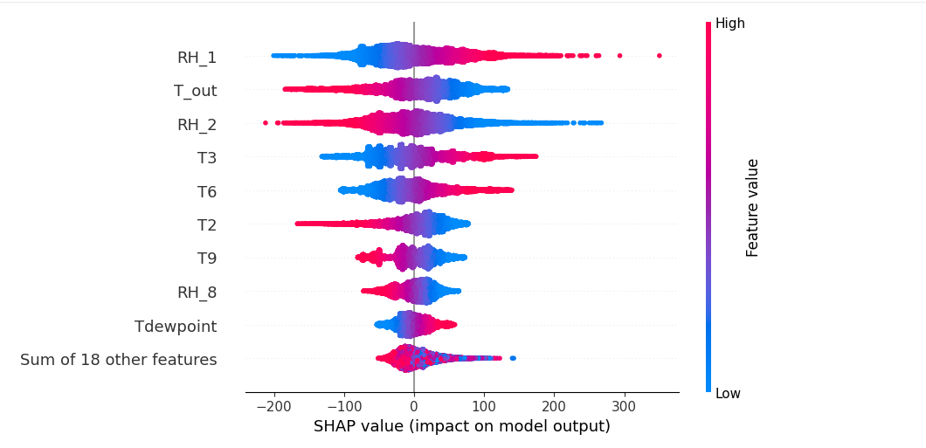
getting the Beeswarm Chart
The beeswarm chart shows the impact of SHAP on model output
Red represents high feature value and blue represents low feature value

Slide 9
Multiplex network-based representation of vision transformers for explainability
MUTEX combines multiplex network-based representations of attention matrices and mask perturbation approaches to provide insight into the inference process of ViTs. By mapping the attention layers of a ViT into a multiplex network, MUTEX can analyze the relationships between different parts of the input image and identify the parts of the image that influence the output inference.
Mutex addresses the non-linearity in patch relationship by constructing a multiplex network on top of the attention matrices, capturing patch interactions across different layers and modelling the information flow within the ViT. MUTEX solves the problem of attention-based approaches by creating masks which connect the attention weight to the output of the model. Based on the output inference, MUTEX identifies salient areas and constructs the final heatmap.

Slide 10
Multiplex network-based representation of vision transformers for explainability
Maps the attention layers of a ViT onto the multiplex network-based representation that highlights the relationships between parts of the input image.
it uses the generated multiplex network to identify the most important patches based on centrality measures and aggregation functions and then constructs a set of masks corresponding to specific parts of the image. It then merges the masks using the Models class confidence score and coverage bias formula. The construction of multiplex-based networks is done several times within the heatmap generated.

Slide 11
AttentionViz: A Global View of Transformer Attention
Although self-attention has been studied, previous techniques generally visualize information related to just a single input sequence at a time.
The primary technique of this research is visualizing a joint embedding of the query and key vectors used by transformers, which then creates a visual signature for an individual attention head.
Gaps this research fills, visualizing query and key embeddings in transformer models; artefacts of self-attention queries and keys are underexplored. Secondly, other research compares multiple embeddings; they do not compare embeddings at different transformer heads and layers, Global matrix was designed to do this.

Slide 12
AttentionViz: A Global View of Transformer Attention
Each attention transformer head turns input embeddings into query vectors and key vectors by applying matrices WQ and WK respectively. These matrices then project the vector embedding to a lower dimensional space, getting only specific information from the higher-dimensional vector embedding .
A key observation is that the relative positions of query and key vectors can offer insight of how attention will be distributed, since attention coefficients depend on the dot product between queries and keys.
Closer distance directly shows higher attention coefficients

Slide 13
AttentionViz: A Global View of Transformer Attention
AN example attention head in language transformer, we obtain the key and query vector representation of each token in each sentence
then use dimensionality reduction techniques such as t-SNE, UMAP or PCA to project the high-dimensional vector into low-dimensional space. The output of the reduction is in 2D/3D scatterplot format; each point represents a single query or key token.
This allows users to explore interactions between queries and keys; these often can visualize the underlying self-attention patterns.
Matrix view, Single view, Sentence/image view,

Slide 14
VisBERT: Hidden-State Visualizations for transformers
This experiment was performed on publicly available QA datasets SQuAD, HotpotQA and bAbI QA to show the tools applicability on three diverse QA tasks including multi-hop reasoning cases.
Dimensionality reduction maps the high dimensional data into low dimensional space form a 2Dimensional representation of data.
The most suitable method for dimensionality reduction in this instance is PCA,
it includes a selection of samples from the test sets of each dataset; the user is also able to enter its own examples.

Slide 15
VisBERT: Hidden-State Visualizations for transformers
the user will get their prediction, 2D graphical representation of token for a given layer because of dimensionality reduction.
The tokens are color coded into Question, supporting fact, context and predicted answer. This way, the distance between tokens can easily be analyzed.

Slide 16
VisBERT: Hidden-State Visualizations for transformers
Topical clustering: In the first layer tokens are clustered based on topical similarities, comparable to a static word embedding like Word2Vec
Connecting Entities with Mentions and Attributes: Middle layers tend to cluster tokens based on their specific context. For instance, multi-token entities clustered together because their tokens share one semantic meaning
Matching Questions with supporting Facts: In the third quarter of BERT layers, we see question tokens, form clusters with supporting fact tokens
Answer Extraction: In the last layer, the answer tokens are separated from all other tokens.

